Slide 1


WORKING CONDITIONS IN MARINE CAPTURE FISHERIES
Dr. Jess Sparks
Friedman School of Nutrition Science and Policy
Tufts University

Slide 2
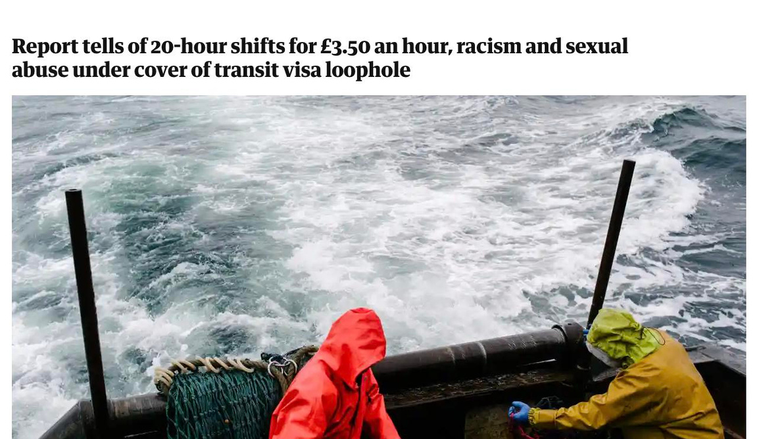
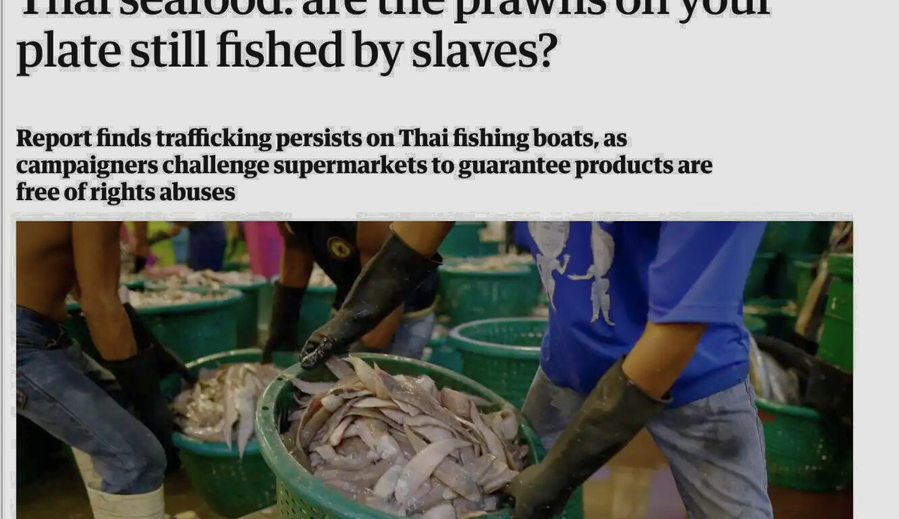
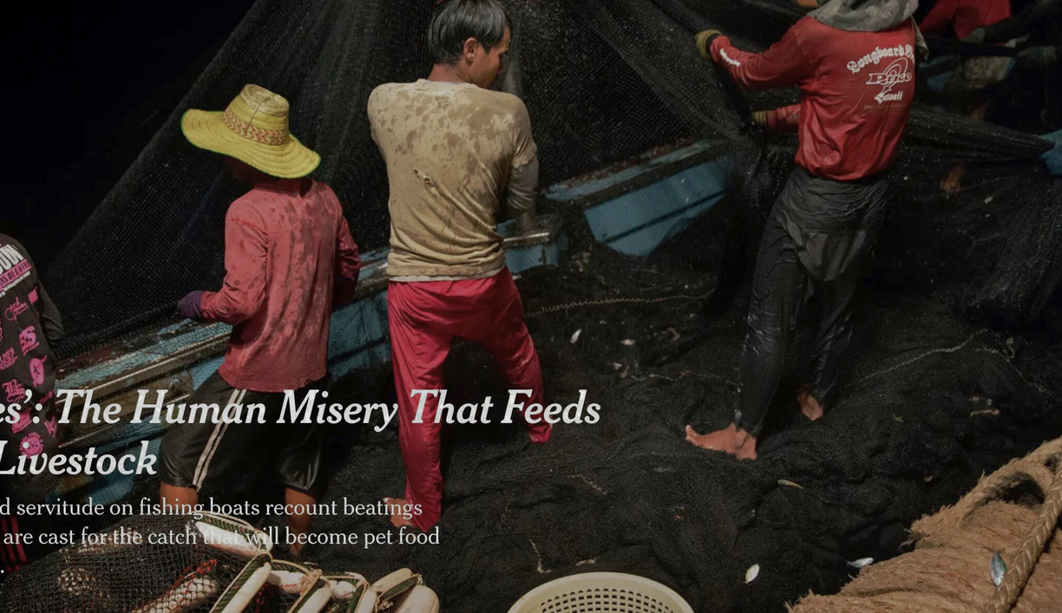
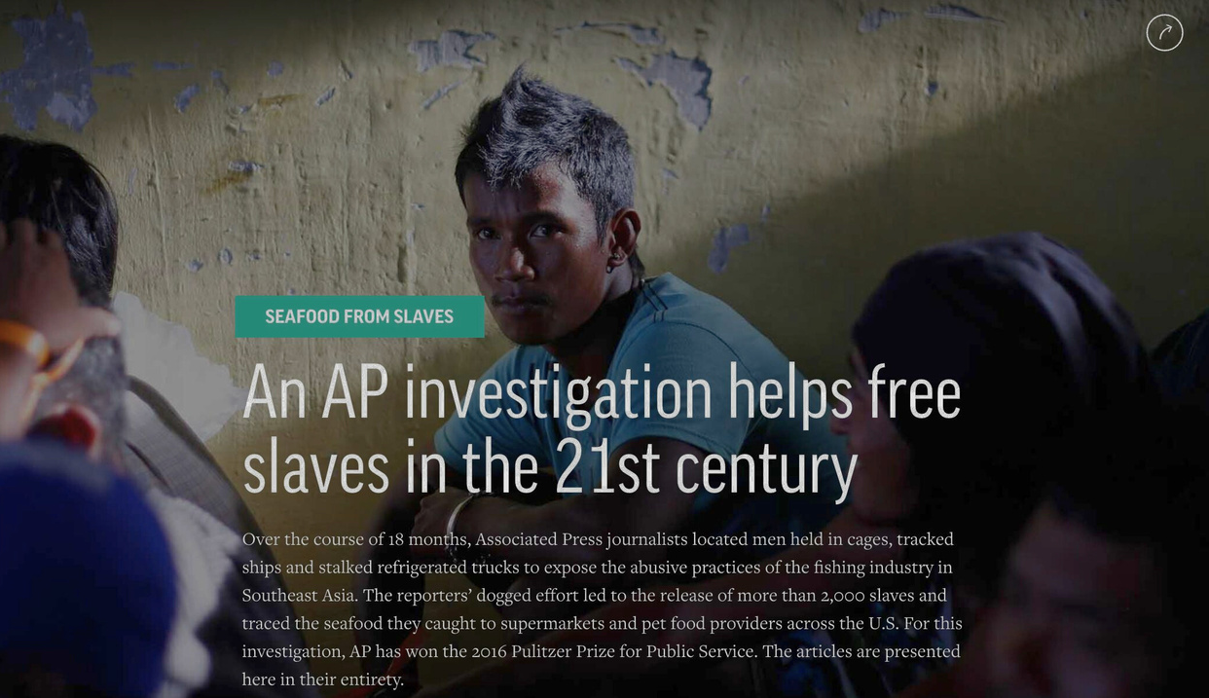
128,000
FISHERS GLOBALLY WORKING IN CONDITIONS OF FORCED LABOR
Source: International Labour Organization, 2022

Slide 3



A CONTINUUM OF WORKING CONDITIONS
Decent
Work
Labor
Abuses
Labor
Exploitation
Human Trafficking
Modern Slavery
Slavery
Servitude
Forced Labor
Violations of labor rights & norms
Violations of labor laws and regulations
less severe
more severe
ILO c29:
Forced Labour Convention
ILO c188: Work in Fishing
ILO c190: Violence and Harassment
ILO c181: Private Employment Agencies
ILO c87: Freedom of Association
ILO c98: Right to Organize and Collectively Bargain
Palermo Protocol
1926 Slavery Convention
Notes:
1

Slide 4
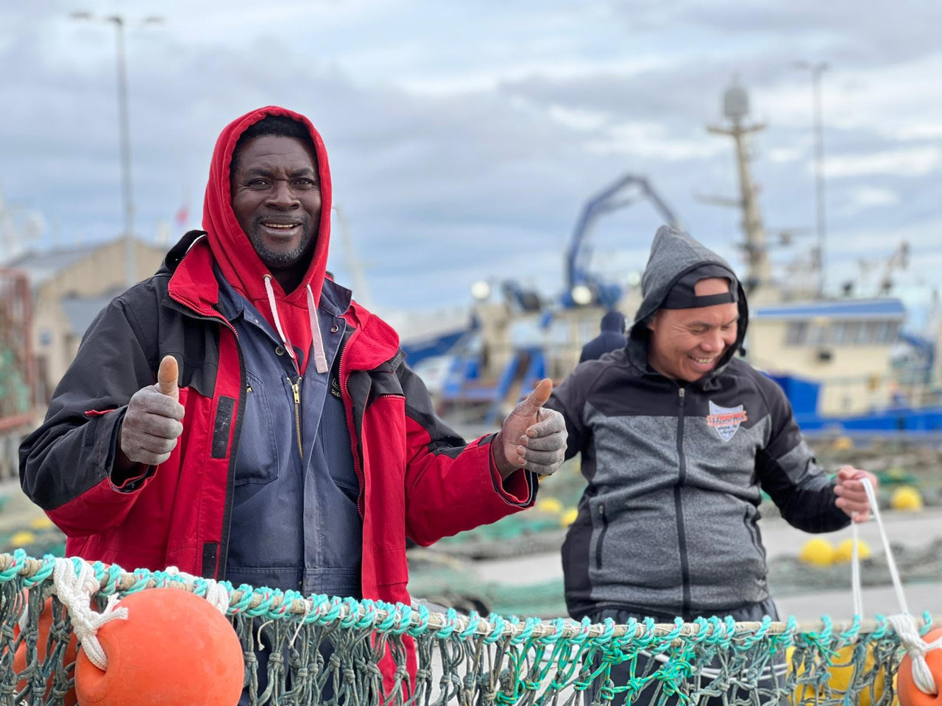
  4,139 SURVEYS
  109 NATIONALITIES
  93% OF SAMPLE IDENTIFIED AS A MIGRANT FISHER
  92 FLAG STATES
  413 PORTS GLOBALLY
  65 COUNTRIES
  VESSEL SIZE RANGING FROM <10 METERS TO >100 METERS
Global Survey of Fishers with Stella Maris & ITF

Slide 5

Category | Definition | Reference Standards
Decent work | ILO definition | ILOC188 minimum standards
Decent work | ILO definition | ILO decent work indicators
Labour abuses | Lawful conditions that fail to meet internationally accepted decent work minimum standards | ILO C188 minimum standards
Labour abuses | Lawful conditions that fail to meet internationally accepted decent work minimum standards | ILO decent work indicators
Labour exploitation | Violations of labor rights and applicable State laws | Flag State laws and regulations, where possible/applicable country of origin laws and regualtions
Forced labour & trafficking | ILO definition and Palermo Protocol | ILO forced labour indicators
Forced labour & trafficking | ILO definition and Palermo Protocol | Palermo Protocol

Slide 6

A CONTINUUM OF WORKING CONDITIONS
FORCED LABOUR
&
HUMAN TRAFFICKING
LABOUR ABUSES
LABOUR EXPLOITATION
DECENT WORK
Approximately
3%
of fishers surveyed.
Approximately 19%
of fishers surveyed.
Approximately 67%
of fishers surveyed.
Approximately 11%
of fishers surveyed.

Slide 7
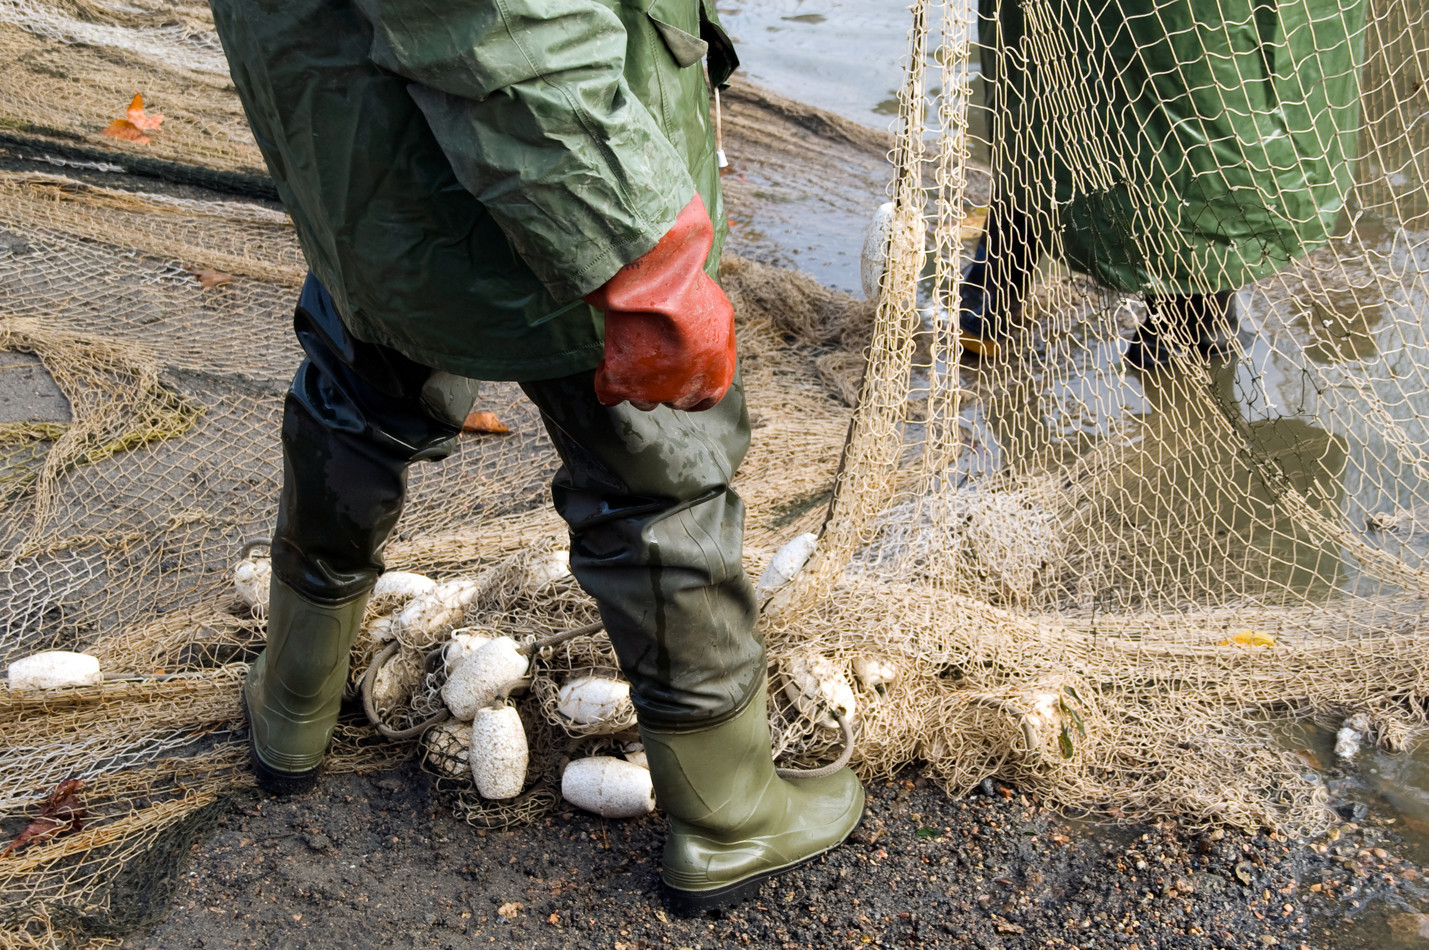
KEY FINDINGS
  The most frequently occurring violation in each of the deficit categories was related to wages
  Adequate rest remains a significant challenge
  Recruitment costs appear to be increasing
  Manifestations of ILO forced labor indicators unique to fishing
  Increasing number of nationalities onboard a single vessel
  Immigration precarity was the most significant predictor of labour abuses, exploitation, and forced labour
  Only 7% of the sample reported being interviewed about their working conditions by an inspector (and less than one quarter of them reported being interviewed in their preferred language)
  Disincentivized from reporting grievances
  Mental health concerns widely reported
Notes:
Wages:
-don't want to leave vessel if they are owed wages because they believe they will never be able to retrieve their wages if they return home
Coerced contract
-related to these other two points
-need to renew to make it worth the amount of debt they accrued
-recruitment costs cheaper if they renew, versus returning home to start all over (particularly in places where port agents operate)
-threatened with denial of repatriation
Nationalities: Language challenges, control, Senegalese fisher from a union said they all had different contracts in different languages which made it more difficult for them to make collective demands of the employer

Slide 8
THANK YOU
jessica.sparks@tufts.edu

