Slide 1
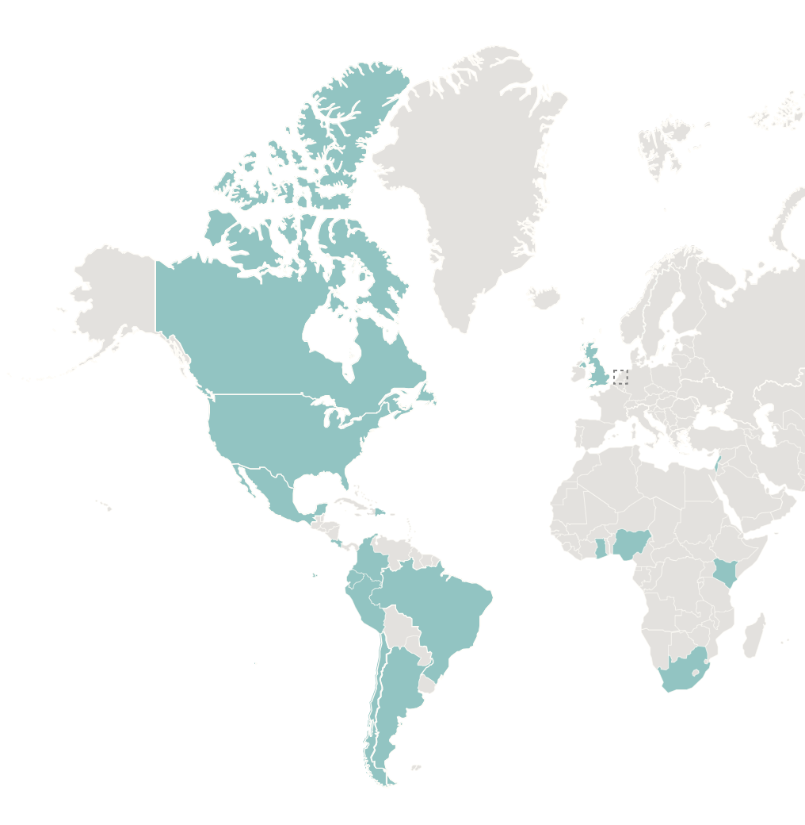
Global Food+ Symposium 2025
ADVANCING FOOD LOSS & WASTE + FOOD DONATION POLICY
Emily Broad Leib
Clinical Professor of Law & Director
Harvard Law School Food Law and Policy Clinic

Slide 2
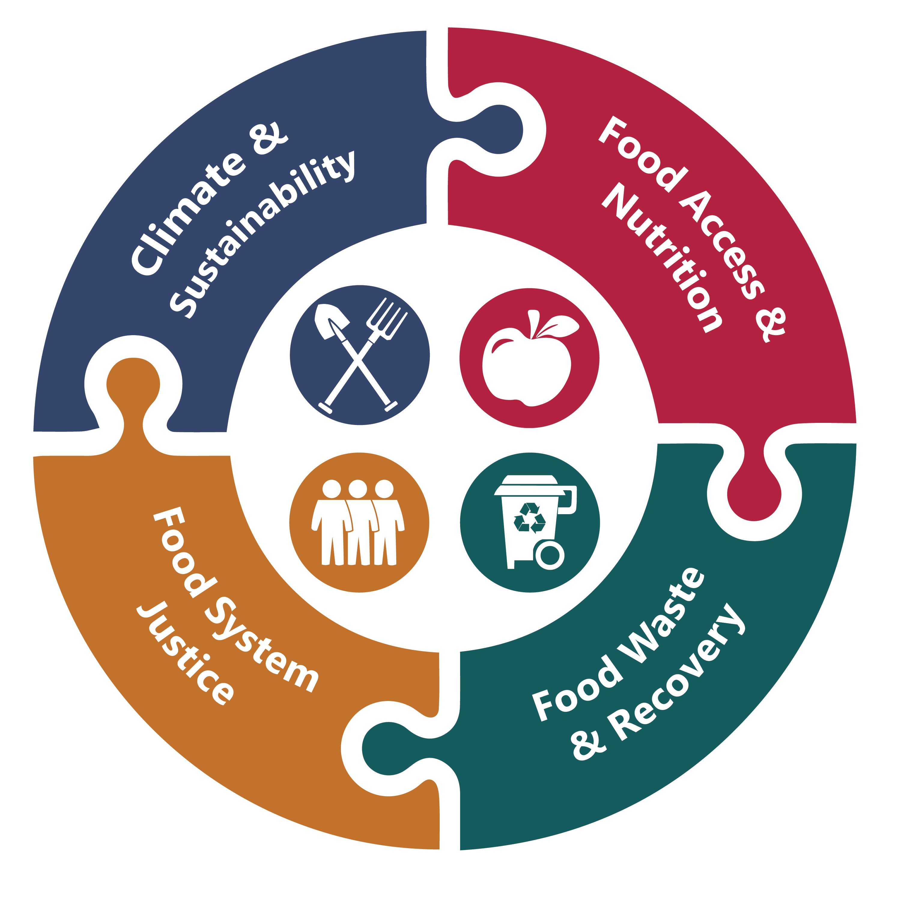
About FLPC
Provide legal and policy advice to nonprofits, government agencies, businesses
Educate students about law and policy in the food system
Harvard Law School Food Law and Policy Clinic

Slide 3
Food Waste & Recovery Portfolio
State & Local
Examples: state bill tracking; technical assistance to state governments
U.S. National
Examples: Zero Food Waste Coalition, Opportunities to Reduce Food Waste in the Farm Bill
Global
Example: Global Food Donation Policy Atlas

Slide 4
The Global Food Waste Problem
Annual global food waste ~ 1.3 billion tons (1/3 of the food supply)
  Food waste contributes 8-10% of global GHG emissions (2019)
  Meanwhile, nearly 800 million people face hunger globally (2023)
Not all of the food that gets wasted is safe and edible, but much of it is...
  ...however, food is highly regulated, and legal frameworks play a critical role in food waste and food recovery
  Understanding what laws help or hinder food waste reduction can enable governments to optimize their policies
  Quickly identifying best practice policies can speed their progress
Sources: UN, State of Food Security and Nutrition in the World (2023); UNEP Food Waste Index Report (2024); UN IPCC, Climate Change and Land (2019)

Slide 5

Global Food Donation Policy Atlas: Goals
IDENTIFY AND ANALYZE LAWS
Explain relevant laws in partner countries (25+ countries)
RECOMMEND POLICY CHANGE
Provide tailored recommendations for each partner country
MAXIMIZE GLOBAL ENGAGEMENT
Present results in an online, interactive atlas tool that allows for comparison between countries and quick identification of best practices
PROVIDE TAILORED TECHNICAL ASSISTANCE
Support in-country partners on policy implementation

Slide 6
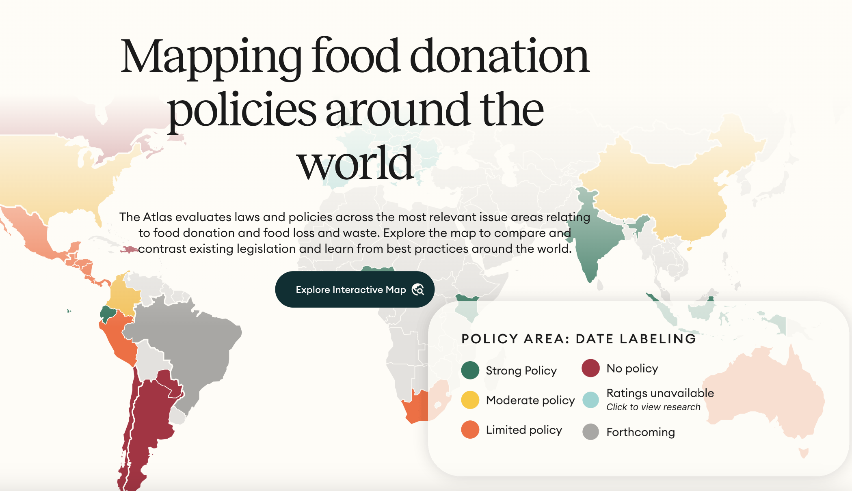
Harvard Law School Food Law and Policy Clinic

Slide 7







Legal Issues
Food Safety
Date Labeling
Liability
Food Waste Law & Policy
Tax Incentives
& Barriers
Requirements
& Penalties
Govt. Grants
& Incentives
Harvard Law School Food Law and Policy Clinic

Slide 8

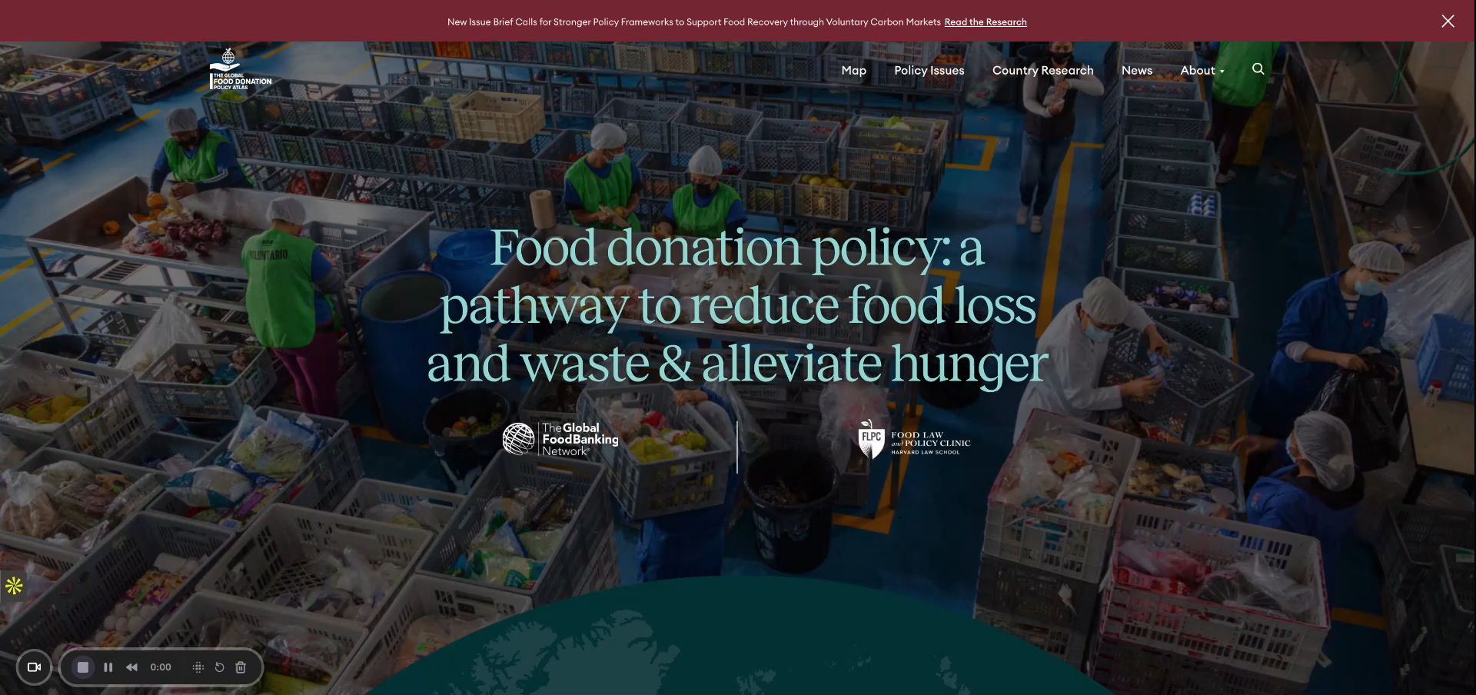

Slide 9
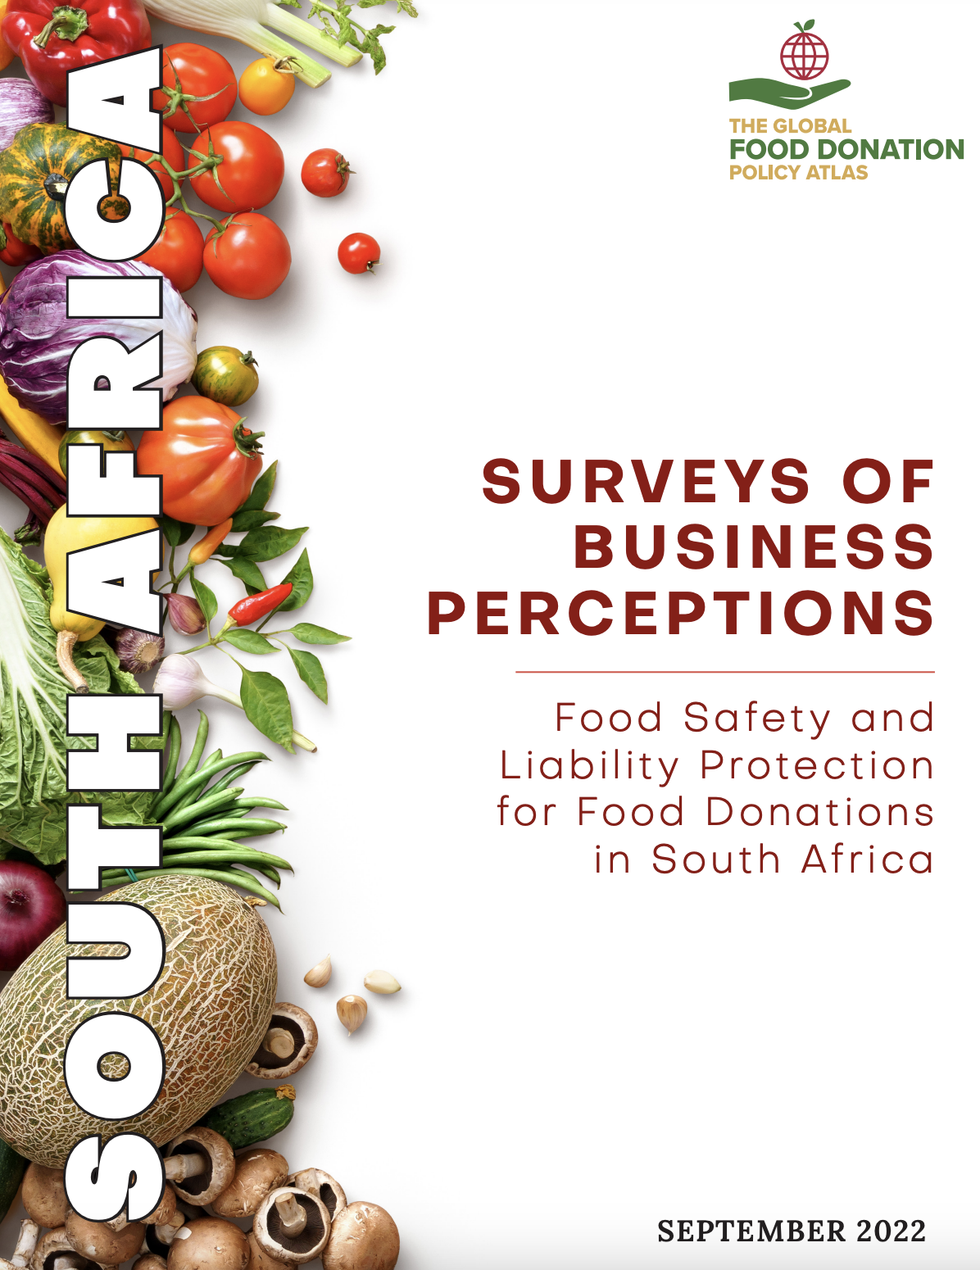

Technical Assistance: South Africa
62.7% of respondents agreed that they would donate more food if legally protected from liability
76.6% of respondents agreed that they would donate more food if the South African government provided official guidance around food safety laws and regulations relevant to donation

Slide 10
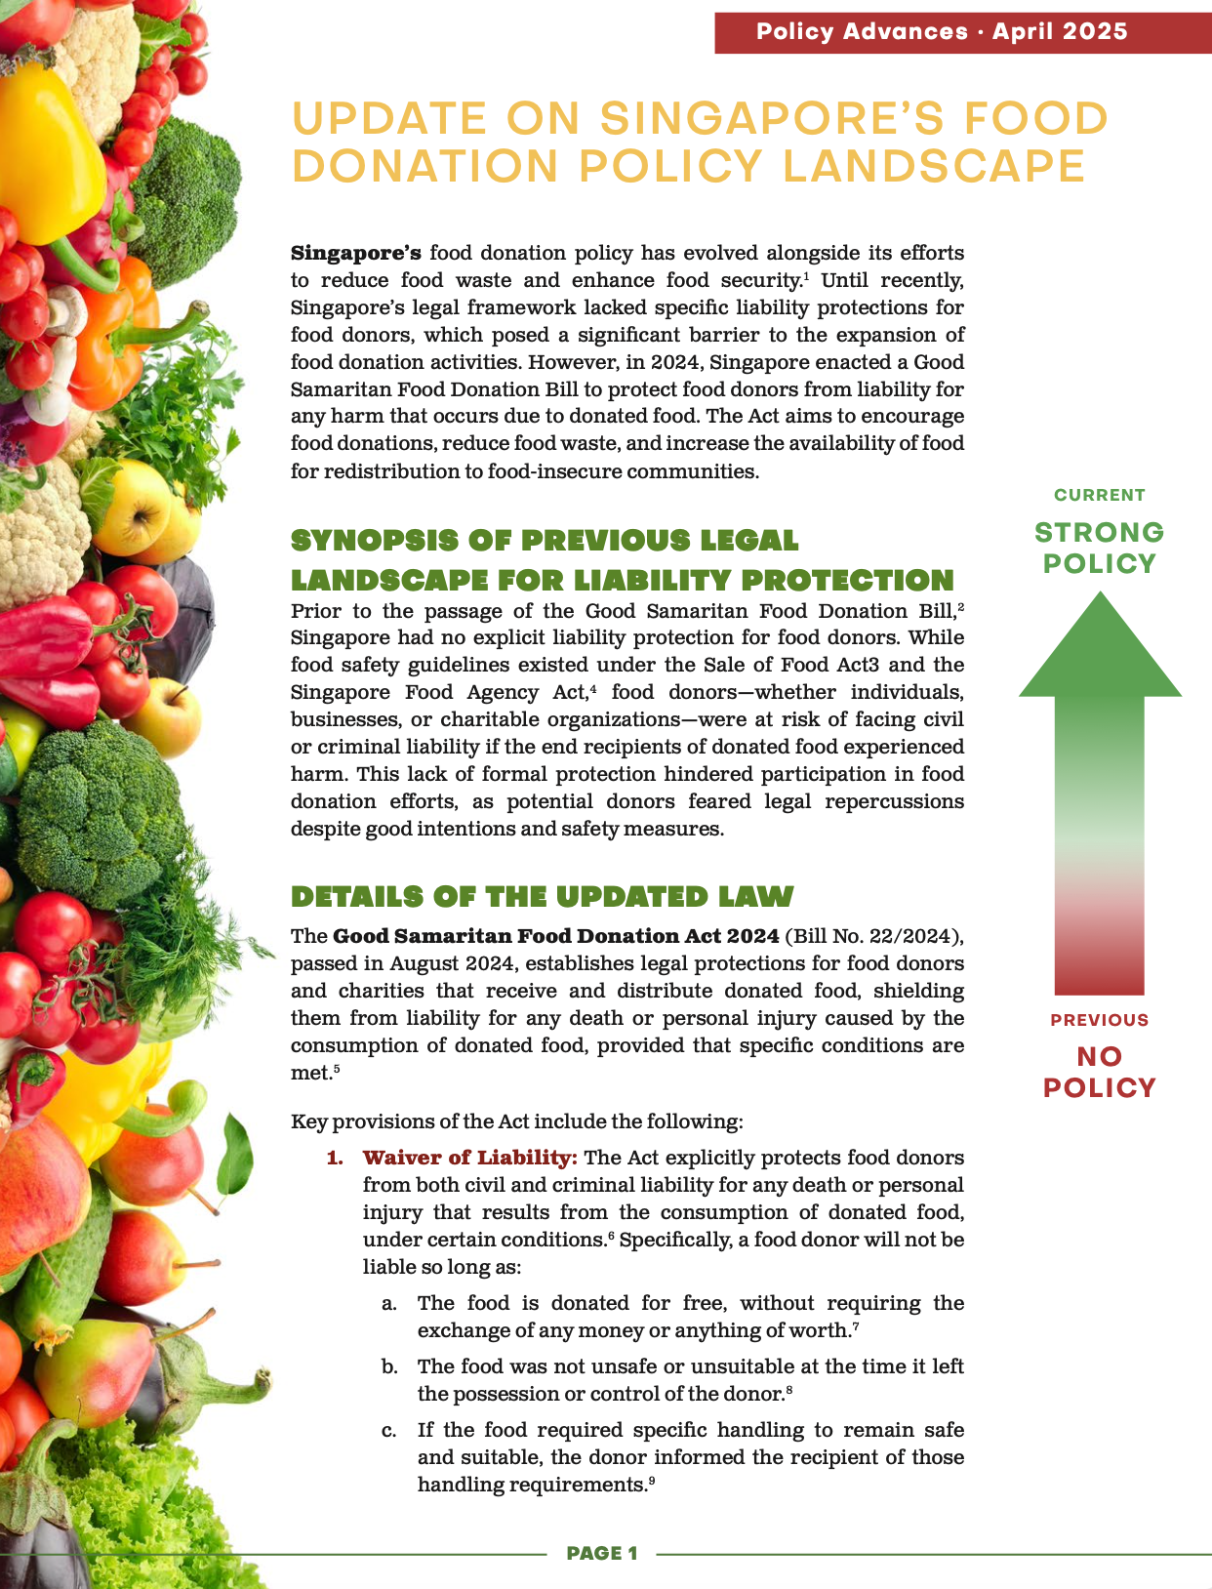
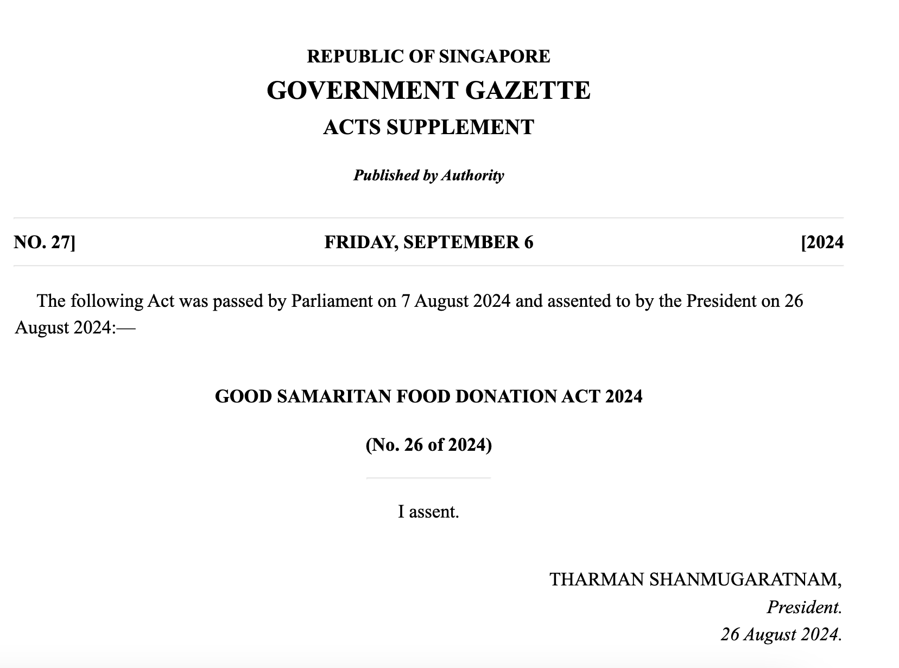
Policy Progress: Singapore

Slide 11
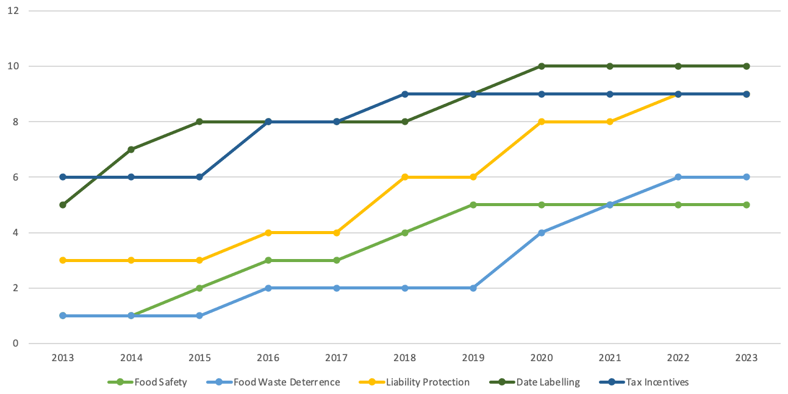
Total Strong & Moderate Policies Over Time

Slide 12
Takeaways
Food waste has enormous economic, social and environmental consequences.
Food recovery can help combat dual crises of hunger and climate change.
Well-designed policies can align incentives, increase clarity, and remove obstacles to food recovery and donation.
Our aim is to speed progress on policies by making recommendations and sharing global best practices.

Slide 13

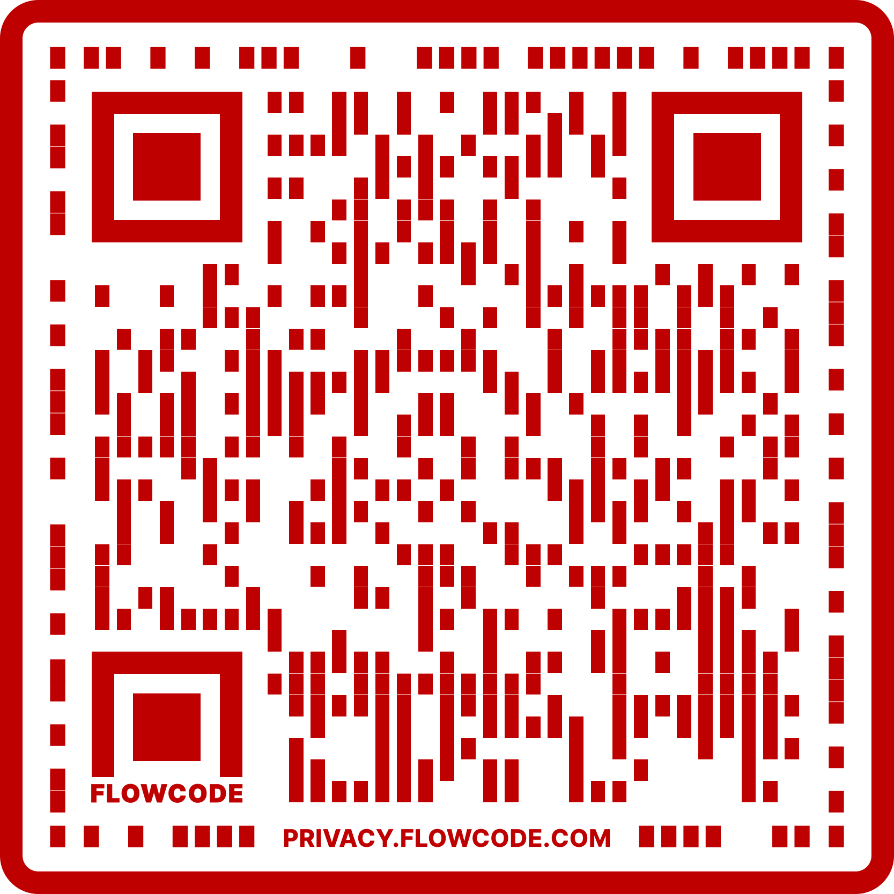


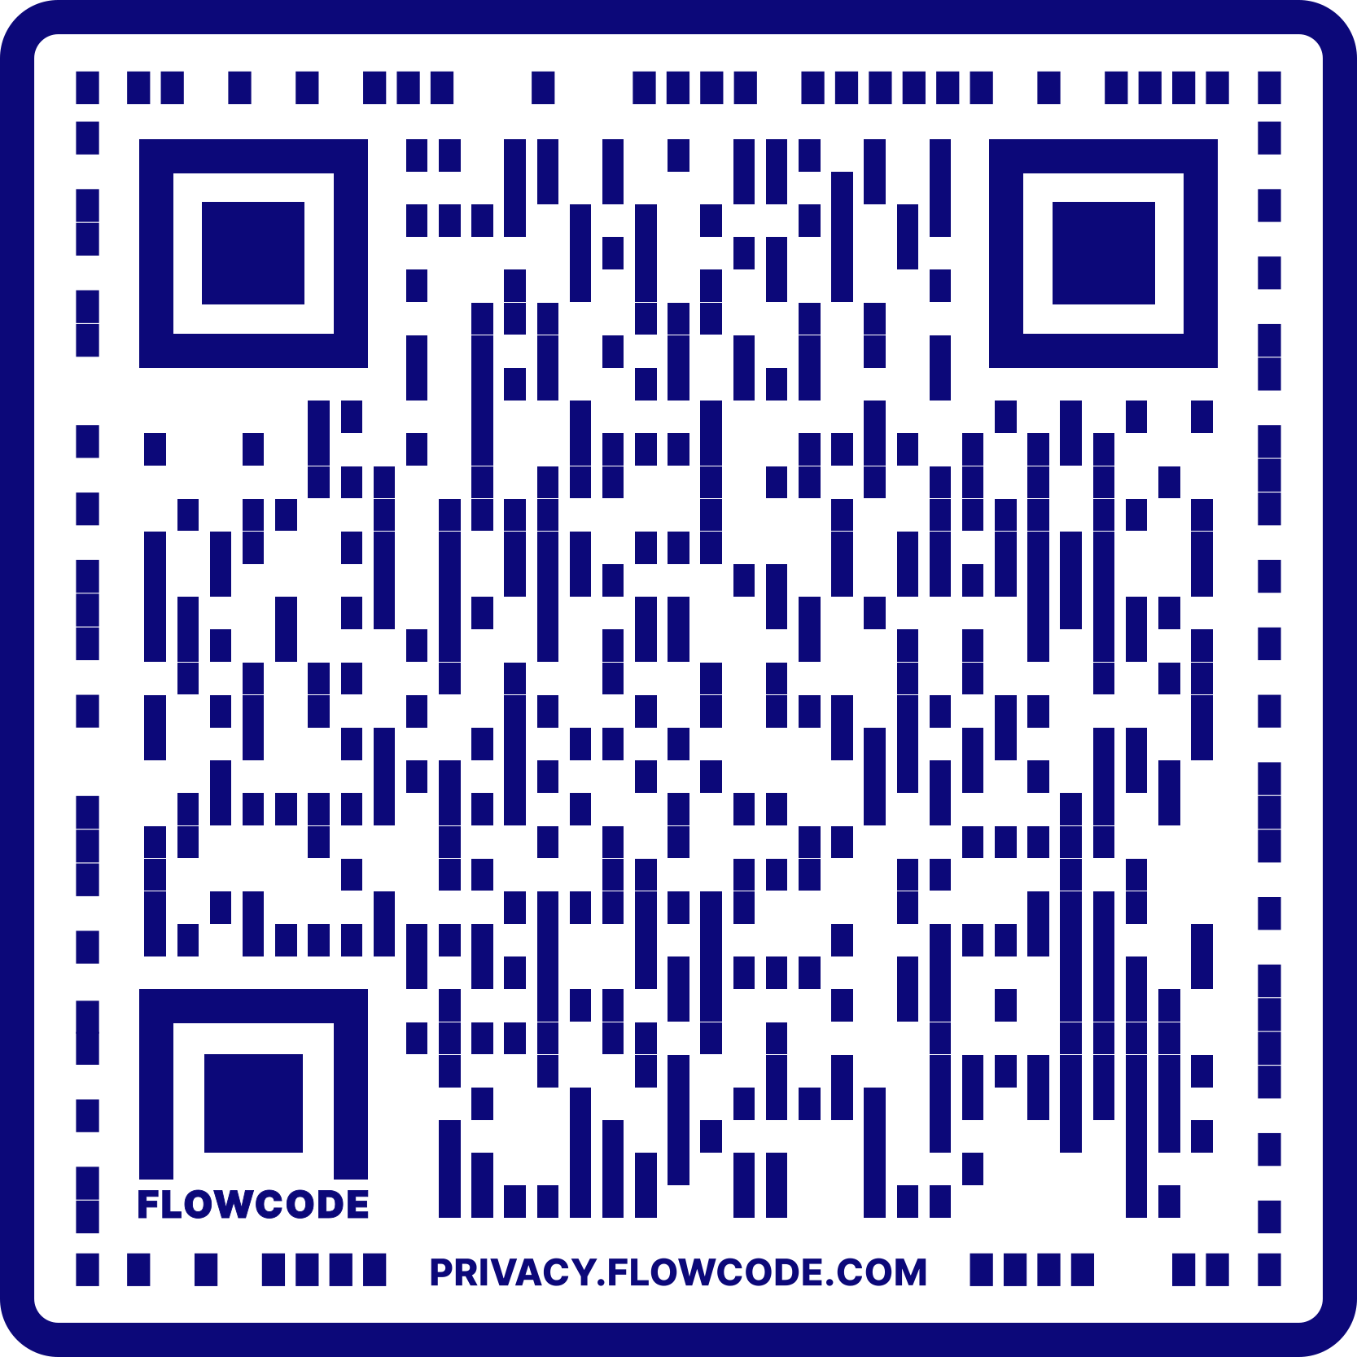

ATLAS PROJECT
Website Link:
https://atlas.foodbanking.org/
FLPC WEBSITE
Website Link:
www.chlpi.org/flpc
Harvard Law School Food Law and Policy Clinic

