Slide 1
Island* and coastal food systems
Khristopher Nicholas, PhD
Assistant Professor in Climate, Agriculture, and Equity
Friedman School of Nutrition Science and Policy
Tufts University
Global Food+ Symposium
May 2, 2025
*poetic license applied

Slide 2

Everything everywhere is an island
(but not all at once)
Notes:
My goal is simple – demonstrate to you that everything is and island and this application in research is actually quite useful

Slide 3
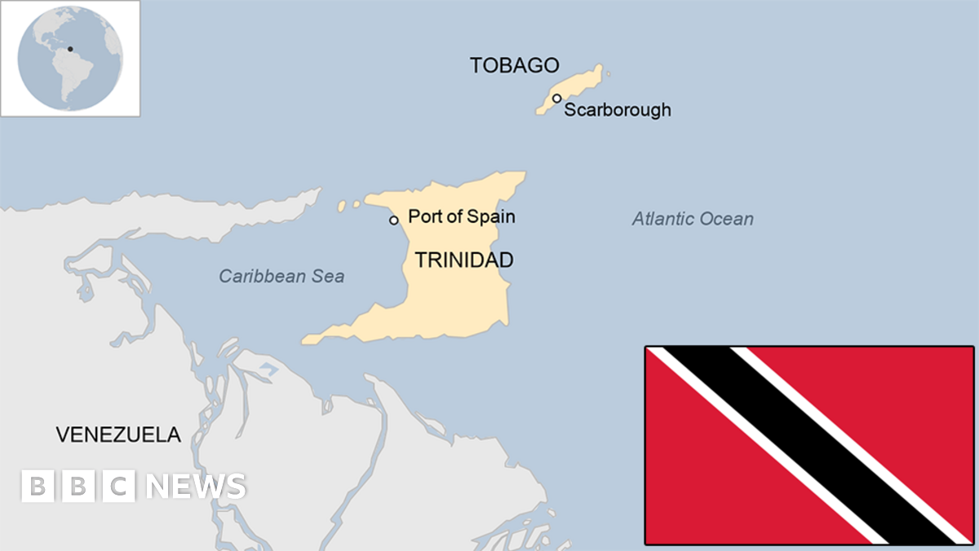
Trinidad and Tobago

Slide 4
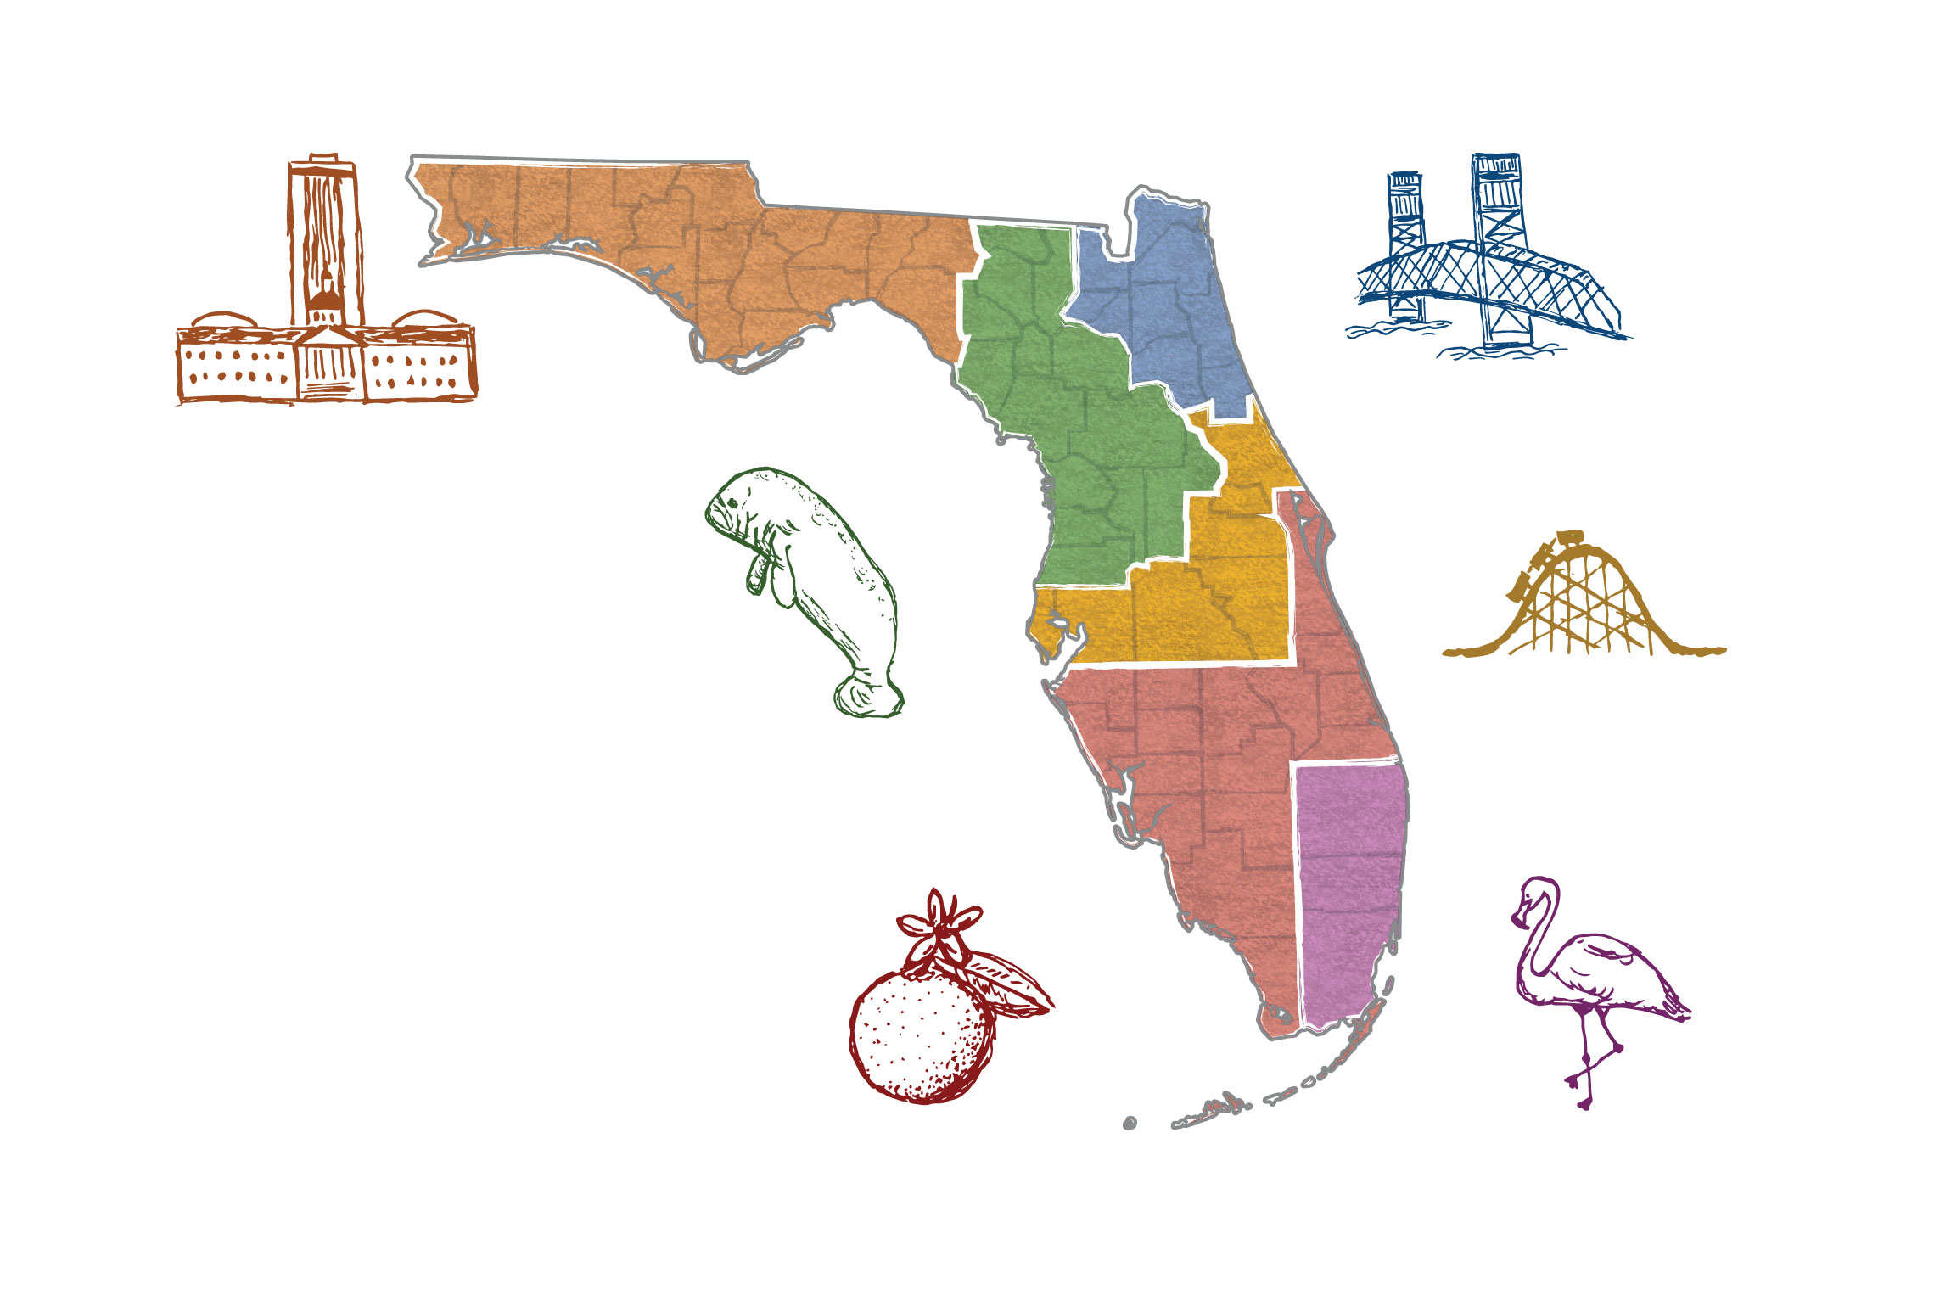
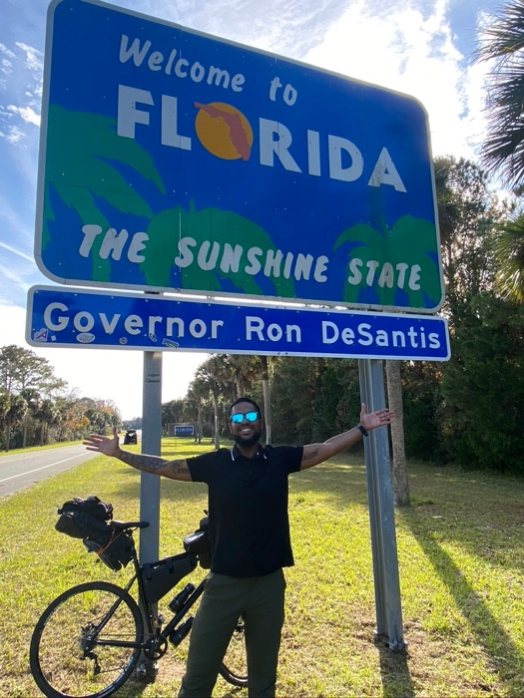
Florida
Notes:
https://www.washingtonpost.com/graphics/2020/politics/florida-political-geography/

Slide 5

What makes an island an island?

Slide 6
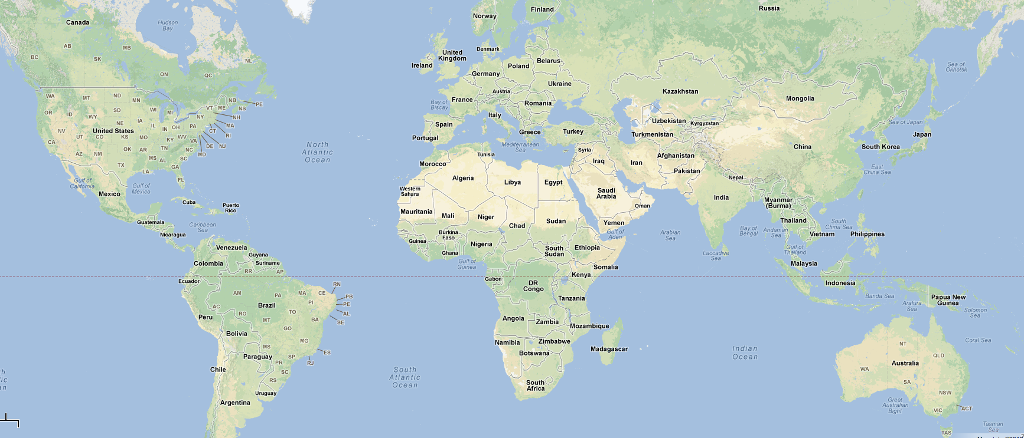
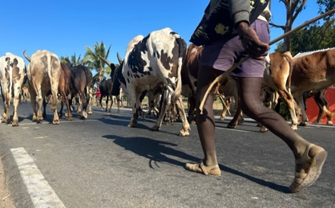
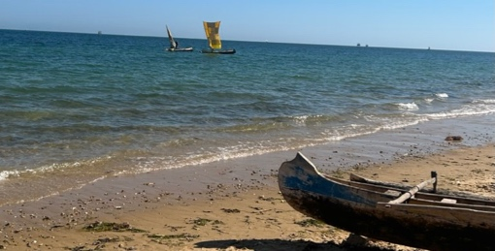
Examples from “typical” island settings
Galápagos,
Ecuador
Madagascar

Slide 7
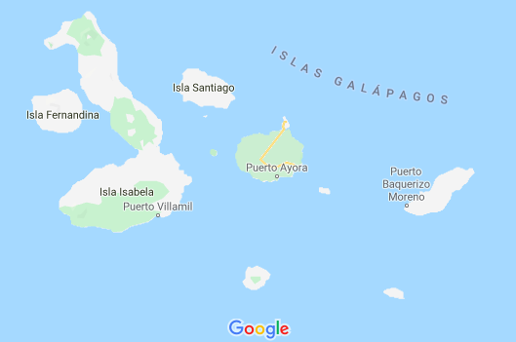
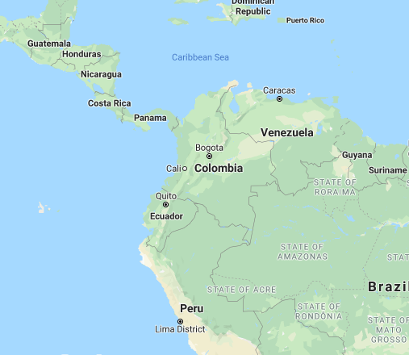
The Galápagos Islands of Ecuador
Notes:
25k people, 7k on San Cristobal, 2k on Isabela, and 16k on Santa Cruz
Most have come from mainland Ecuador beginning in the 60s/70s and population has exploded. Now migration strictly limited
97% of land is national park – extremely limited local farming

Slide 8
Galápagos Food Environments
Markets
Tourism
Economy
Limited local
production
Galápagos Food
Environment
Dual burden
of health
Reliance on
imported foods
Shifting dietary
preferences
Notes:
Tiendas = virtually sole source of food. Important- that we can assess totality of food env is important for our approach
Fruits/vegetables (F/V) imported from mainland
Delays, Price Price: barge vs. airplans, Quality
Locally produced F/V more expensive + less variety. 2% of land available
Tourism economy: artificially high prices on the islands for lots of common items
Preferences: latin American diet characterized by lots of starches, carbs, rice. Processed foods and lots of juice
Underlying context: dual burden of health. 9% of children and 63% of adults OW/OB in Ecuador (Freire, Belmont et al, 2013). Yet we still see conditions like iron deficient anemia and infectious disease from poor water quality, for example
23m

Slide 9
Galápagos Food Environments
Reliance on
imported foods
Galápagos Food
Environment
Notes:
Tiendas = virtually sole source of food. Important- that we can assess totality of food env is important for our approach
Fruits/vegetables (F/V) imported from mainland
Delays, Price Price: barge vs. airplans, Quality
Locally produced F/V more expensive + less variety. 2% of land available
Tourism economy: artificially high prices on the islands for lots of common items
Preferences: latin American diet characterized by lots of starches, carbs, rice. Processed foods and lots of juice
Underlying context: dual burden of health. 9% of children and 63% of adults OW/OB in Ecuador (Freire, Belmont et al, 2013). Yet we still see conditions like iron deficient anemia and infectious disease from poor water quality, for example

Slide 10
Underlying Research Question
What is the relationship between and
Part 1
Part 2
food environments
diet quality
for Galápagos Islands residents?
Part 3
Notes:
Highlight that they are 3 independent methods – spatial analysis, nutrition epi, and qualitative community-engaged research

Slide 11
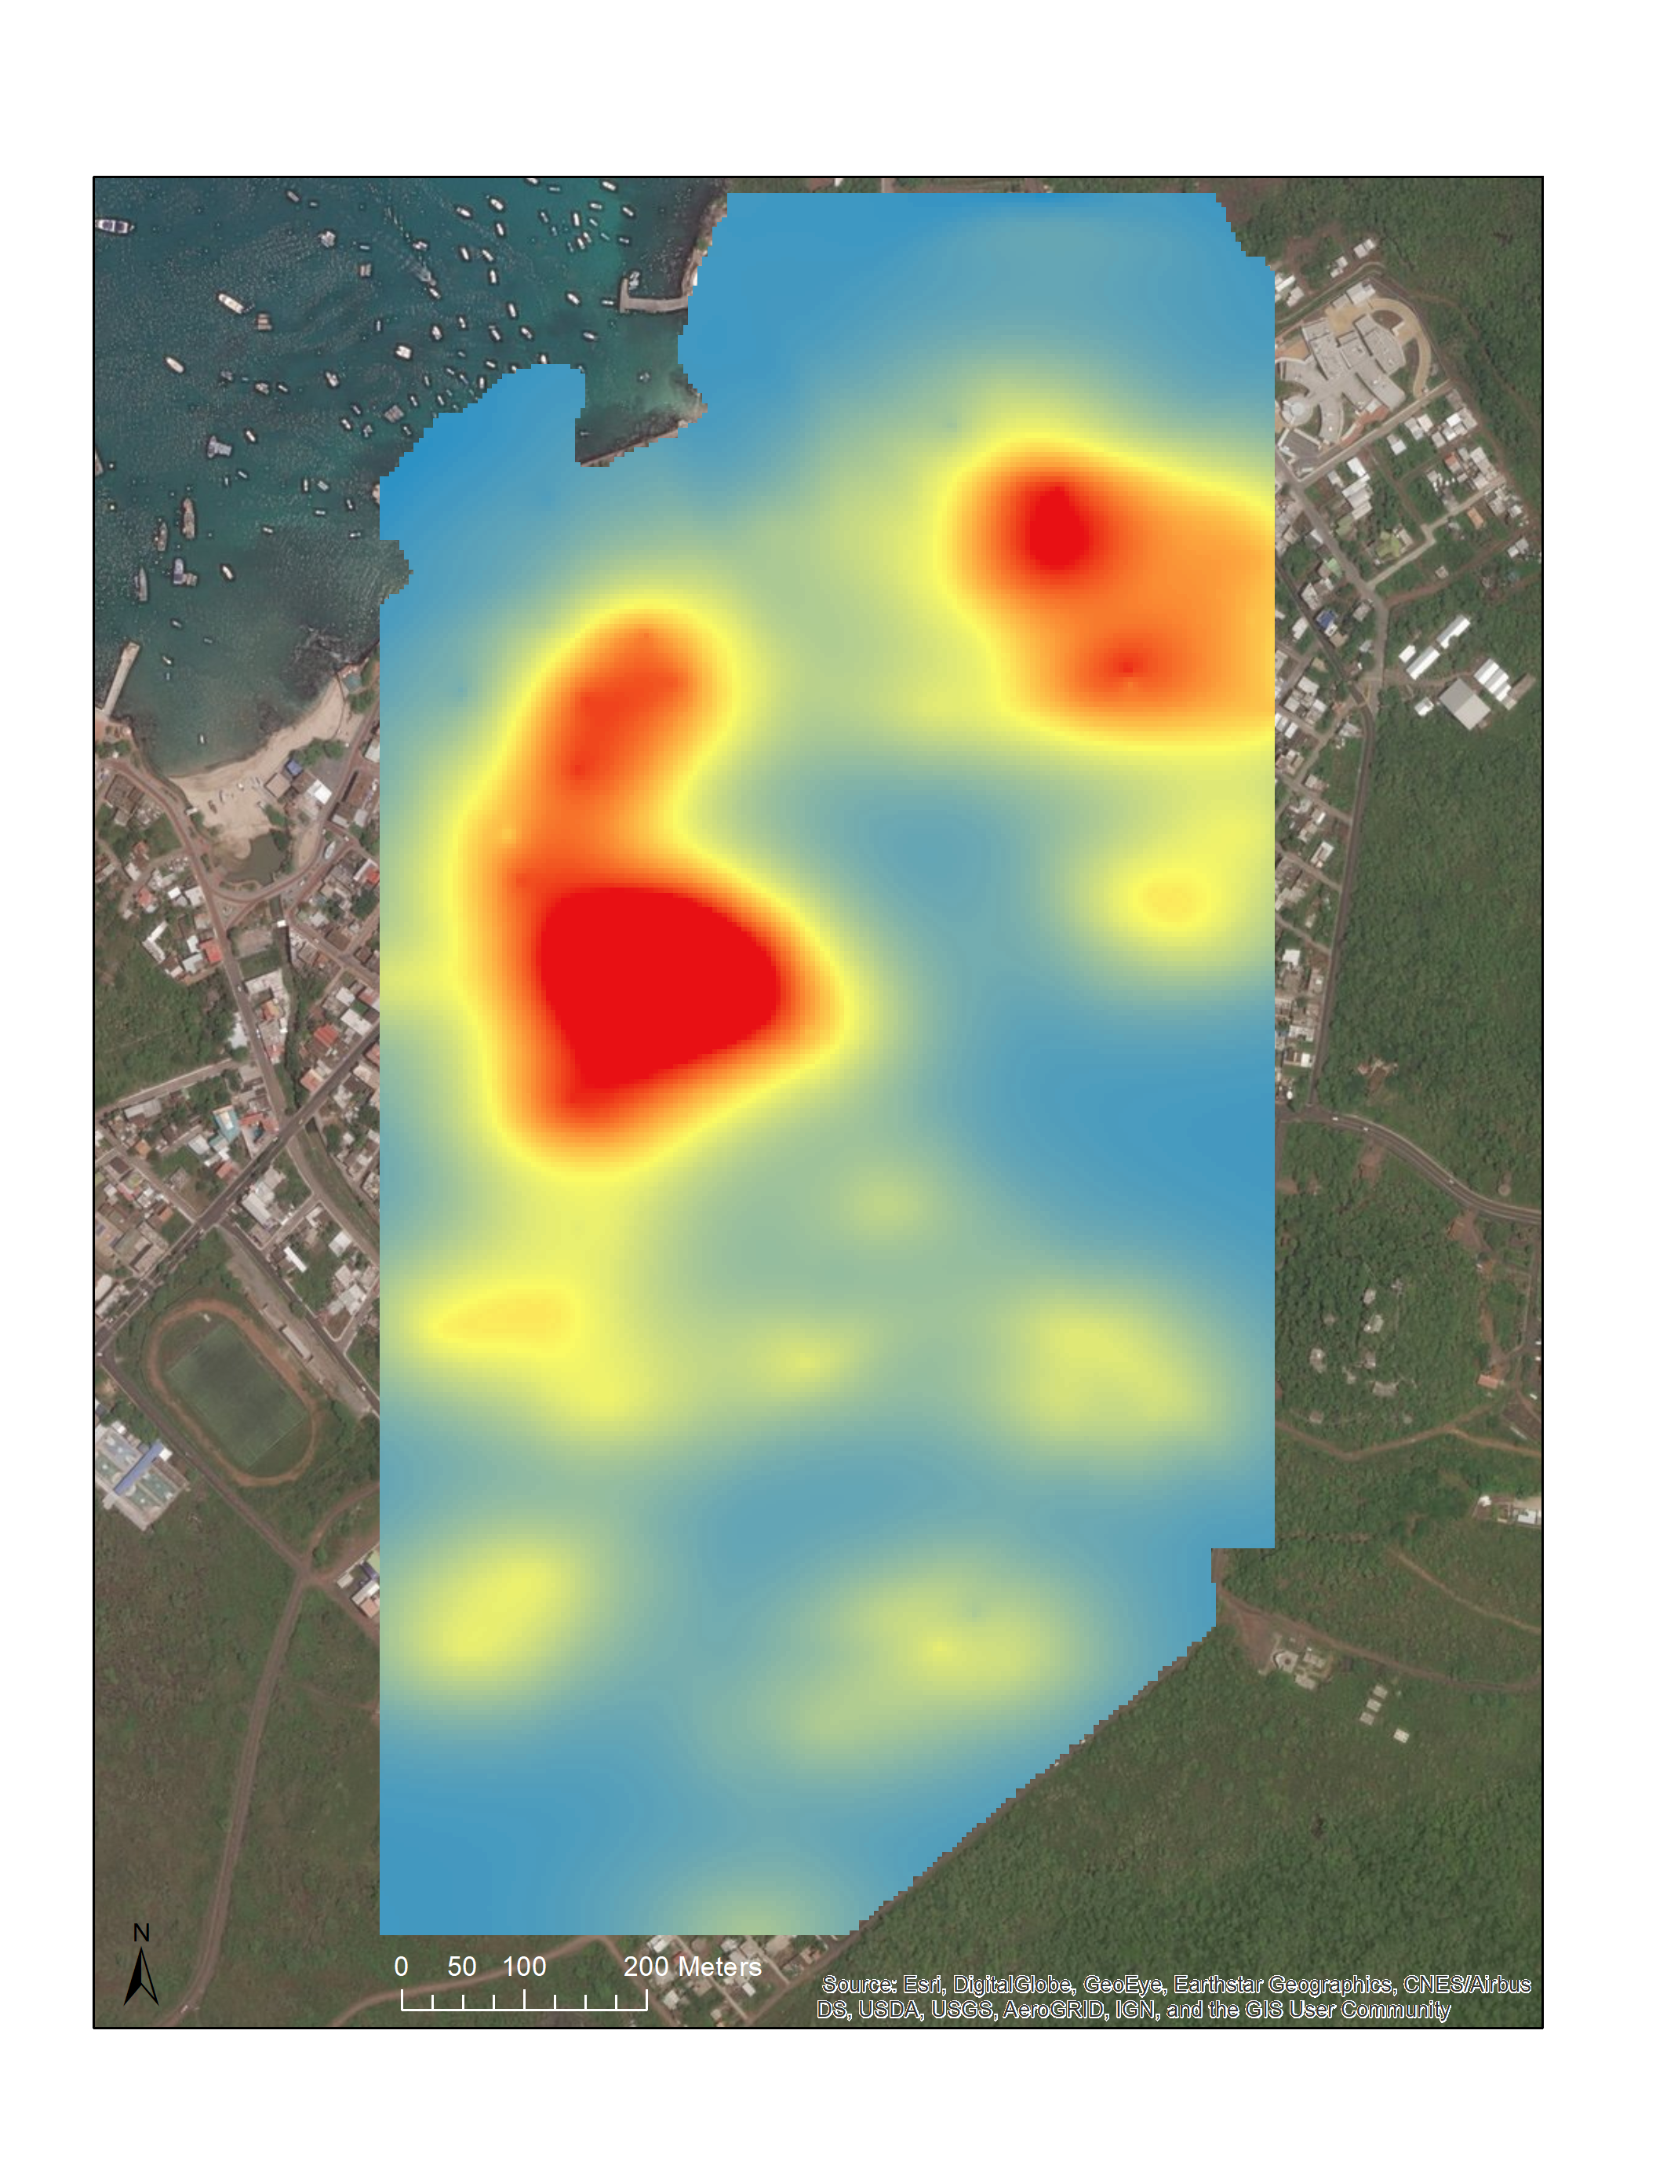
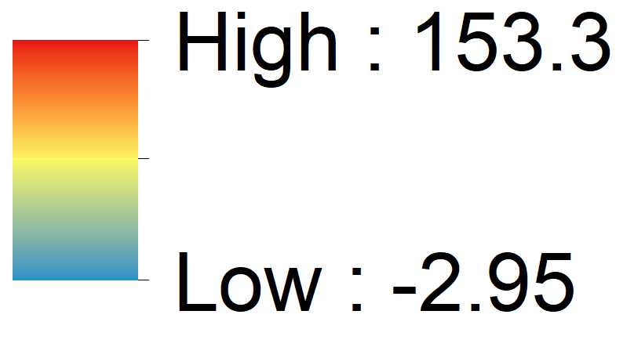
Part 1a:
Food Environment Scores
(Geographic food environment)
Food Environ.
Q x A
Municipal
Market
Nicholas et al., 2022
Notes:
Looking at histograms, what’s happened?
Basically we took the distribution observed for quality and then brought the mode towards zero (and mean too but check mean without outliers). Made it from left skew into having right skew. Basically took it from the 20s on which there were a lot at first and spread them out to higher numbers, esp the 30-50s. Means that access (proximity) works to most resident’s advantage. If it were the opposite, the higher access would be near markets with bad scores and we would see a leftward shift of the curve

Slide 12

Part 1a:
Food Environment Scores
(Geographic food environment)
Food Environ.
Q x A
Municipal
Market
Nicholas et al., 2022

Slide 13
Part 1a:
Food Environment Scores
(Geographic food environment)
M_{near}
Food Environ.
Q x A
Municipal
Market
Nicholas et al., 2022

Slide 14
Part 1a:
Food Environment Scores
(Geographic food environment)
Food Environ.
Q x A
M_{preferred}
Municipal
Market
Nicholas et al., 2022
Notes:
16m

Slide 15
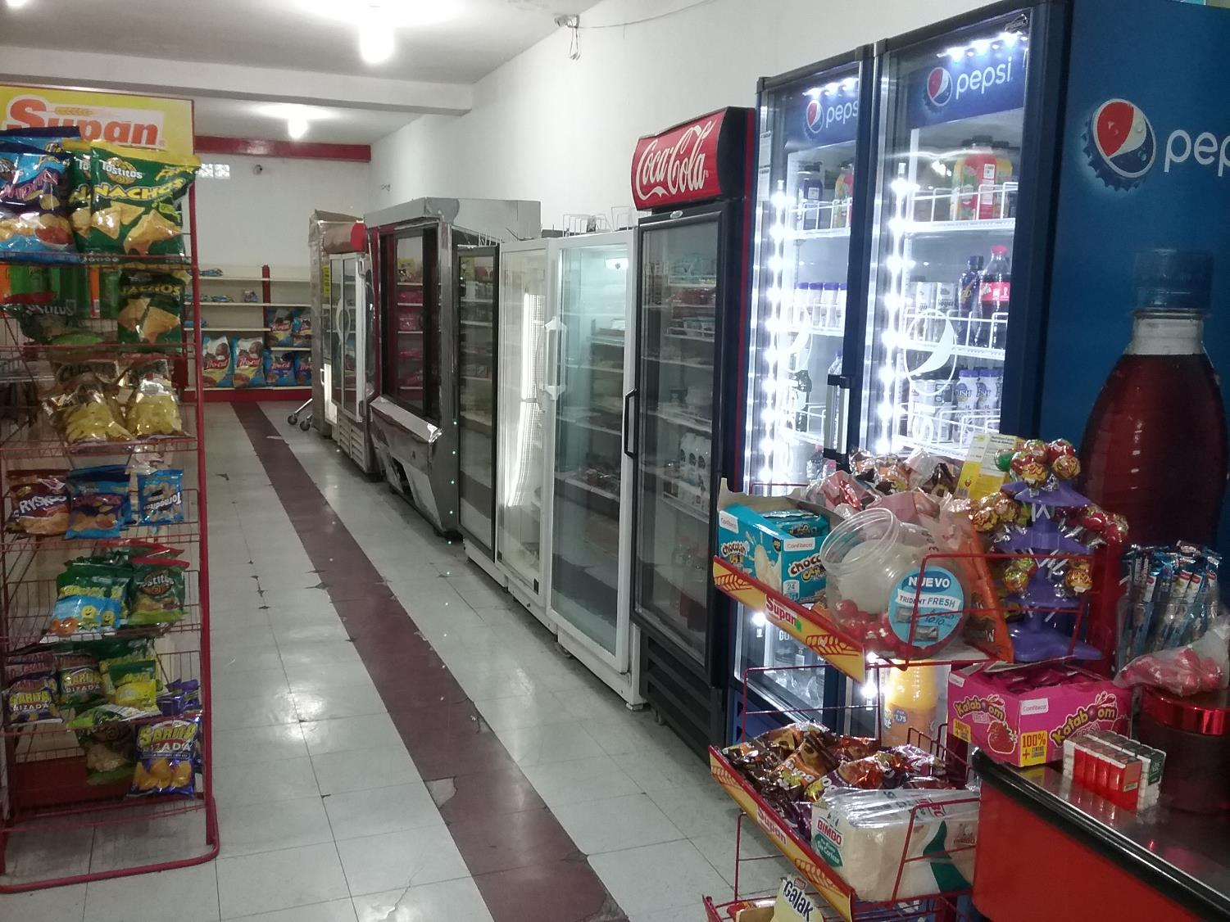
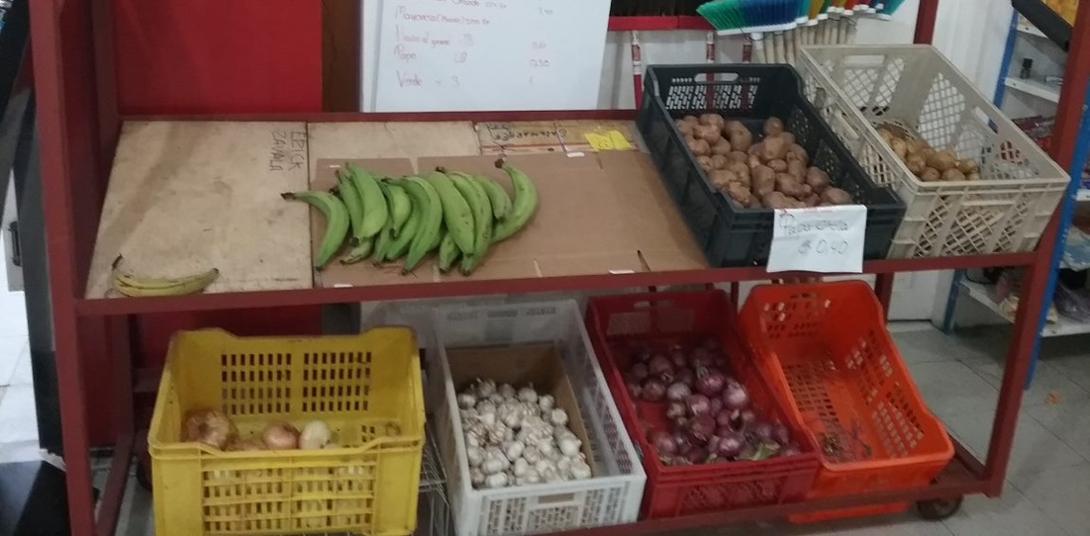
Part 1b: Food Purchasing Behavior
(Experienced food environment)
We developed 34 questions posed to the primary food preparer. Examples:
  “What determines which markets you shop at?” (e.g. proximity, price, quality)
  “What do you do if your market does not have the foods you are seeking?”
  “Given reduced financial and transportation barriers, would you travel farther or spend more to obtain healthier food items? How much more?”

Slide 16
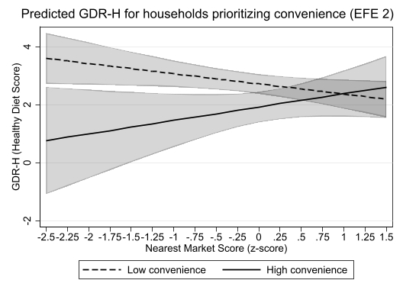
Part 2: Linking food environments to diet quality
Interaction: geographic and experienced food environments
Predicted diet quality for households prioritizing convenience

Slide 17
Part 2: Linking food environments to diet quality
Interaction: geographic and experienced food environments
The same food environment shapes diets differently for different households depending on their food purchasing behavior.

Slide 18
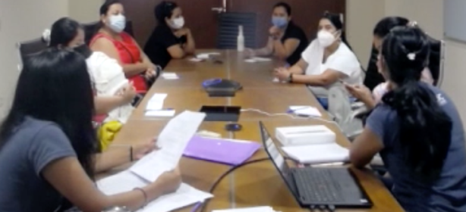
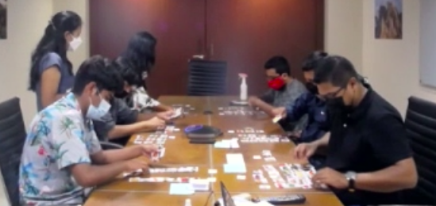
Part 3: Understanding community values around healthy eating and relationships with local food environments
Focus Groups:
Community consensus + individual experiences
Interactive group dialogue (including disagreements)
Sex-specific groups
Notes:
Sex specific for 2 reasons:
. mixed focused groups comprised of both men and women had a tendency to center men’s perspectives and experiences (e.g. as sole income earners, as heads of household, etc.) and marginalize women’s experiences, especially those related to food acquisition and preparation dynamics within the household.
Given the potential influence of cultural norms around body size, diet habits, and household decision making, we wanted to create a focus group environment where participants felt comfortable sharing potentially vulnerable lived experiences with others that have a shared background.

Slide 19
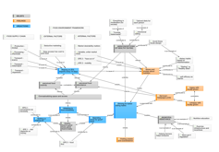
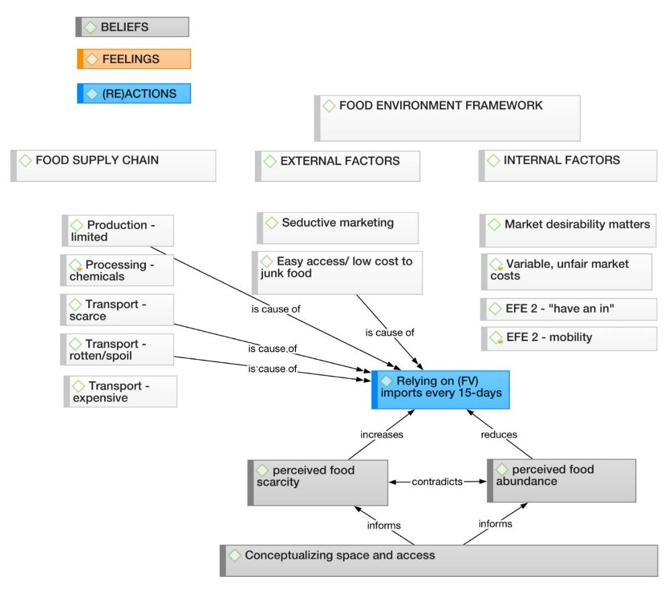
Conceptualizing space and access
“…where we live is not that big, so you can move from one neighborhood to another and you can find the products”
(P11, M, 25-30, public employee)
compared to:
“There are no stores in my neighborhood. [all laugh]
So, it was also difficult to buy those [foods].”
(P23, M, 20-25, student/musician)
Abductive
Thematic
Network
Analysis
(ATNA)
Nicholas et al., 2023

Slide 20
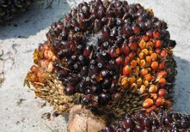
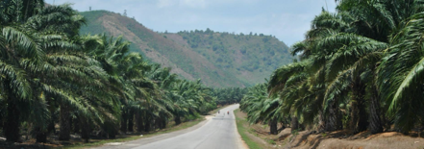
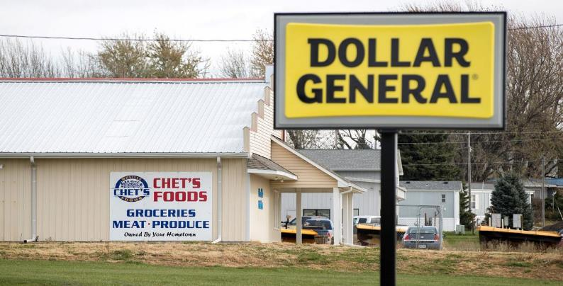
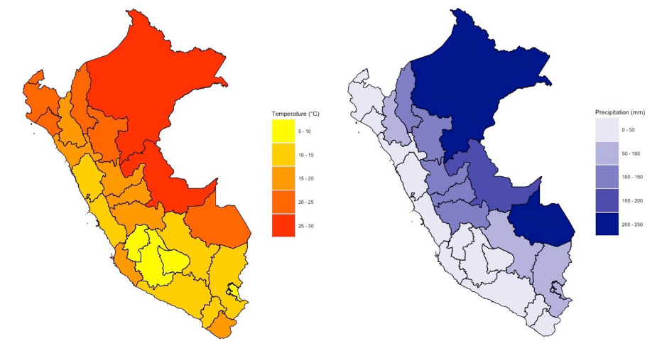
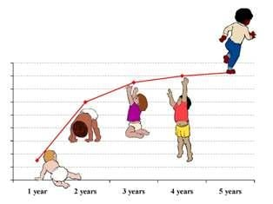
Islands are defined by (the processes that lead to) isolation
Oil palm farming and biodiversity loss
Nicholas et al., 2018
Downs et al., 2021
North Carolina
SNAP/WIC in rural Black communities
Nicholas et al., 2023
Myanmar
Peru
Climate and stunting
Nicholas et al., 2021

Slide 21
Thank you!
Khristopher.Nicholas@tufts.edu

